Slide 1
JavaScript
Interacting with HTML

Slide 2
JavaScript can be used to
modify HTML elements
modify HTML attributes
modify CSS styles
remove existing HTML elements and attributes
create new HTML elements and attributes
react to existing HTML events
create new HTML events
...and more!

Slide 3
Including JavaScript
Just like with CSS, your JavaScript code can either live directly in the HTML
<script>
function foo() {
...
}
</script>
Or in a separate file included by the HTML
<script type="text/javascript" src="click.js"></script>
Keeping your JavaScript separate is the preferred practice!

Slide 4
Key terms
A property is a value that you can get or set (like changing the content of an HTML element)
innerHTML is a property
A method is an action you can do (like add or deleting an HTML element)
getElementById() is a method
<html> <body> <p id="demo"></p> <script> document.getElementById("demo").innerHTML = "Hello World!";
</script> </body> </html>

Slide 5
Working with HTML elements
You can select HTML elements using selectors
by id var myElement = document.getElementById("intro");
by tag name var x = document.getElementsByTagName("p");
by class name var x = document.getElementsByClassName("intro");
by CSS selectors var x = document.querySelectorAll("p.intro");
by Object collection var x = document.forms["frm1"];
var text = "";
var i;
for (i = 0; i < x.length; i++) {
text += x.elements[i].value + "<br>";
}
document.getElementById("demo").innerHTML = text;

Slide 6
Working with HTML elements
Write directly to the HTML output stream
document.write(Date());
Change the content of an HTML element
document.getElementById("p1").innerHTML = "New text!";
var element = document.getElementById("myHeader");
element.innerHTML = "New Header";
Change the value of an attribute
document.getElementById("myImage").src = "landscape.jpg";

Slide 7
Working with HTML elements
Change the style of an HTML element
document.getElementById("p2").style.color = "blue";
Change the style of an HTML element in response to an event
<button type="button" onclick="document.getElementById('id1').style.color = 'red'">
Click Me!
</button>
Create a new HTML element
var para = document.createElement("P"); // Create a <p> element
var t = document.createTextNode("This is a paragraph."); // Create a text node
para.appendChild(t); // Append the text to <p>

Slide 8
But wait!
Sometimes the JavaScript file runs before the HTML is ready, which means that the selectors in your JavaScript code would be trying to grab non-existent elements. To prevent this, you can pass all your code as a function to an event listener listening for the DOM being loaded:
document.addEventListener("DOMContentLoaded", function(event) {
// Your JavaScript code
});
There are better practices to address this issue that we’ll be covering later on.
Notes:
The JavaScript file would run before the HTML if the JavaScript file loads faster than the HTML file.

Slide 9
That’s it for Javascript with HTML
Any questions?

Slide 10
Question: Now we know how to use Javascript to manipulate the webpage, but how do we get JavaScript to dynamically respond to user interactions?
Answer: Events and event listeners!

Slide 11
Events
Events can be:
click
mouseover
keydown
...and more!
How to assign events to DOM Elements?
<script>
document.getElementById("myBtn").onclick = displayDate;
function displayDate() {
...
}
</script>

Slide 12
Event listeners
Attaches an event handler to an element without overwriting existing event handlers.
You can attach many event handlers to one element.
You can attach many event handlers of the same type to one element, i.e. two "click" events.
removeEventListener(event, functionName)
Why is this a better way?
Notes:
Allows for multiple different actions on an event--not limited to one

Slide 13
Event listeners – basics
We can use JavaScript to change the webpage when the user does something.
// Gets the element with id “myElmt”
document.getElementById(“myElmt”);
// Do something when myElmt is clicked
document.getElementById(“myElmt”)
.addEventListener(“click”,
function() {
...
});

Slide 14
Event listeners – basic example
index.html
<html>
<script type=“text/javascript” src=“click.js”>
</script>
<body>
<div id=“theDiv”>Unclicked</div>
</body>
</html>
In click.js
var theDiv = document.getElementById(“theDiv”);
theDiv.addEventListener(“click”, function() {
theDiv.innerHTML = “Clicked!”;
});
We want a <div> that initially says “Unclicked” and changes to “Clicked!” when a user clicks on it.

Slide 15
Event listeners – more complex example
index.html
<html>
<script type=“text/javascript” src=“click.js”>
</script>
<body>
<div id=“theDiv”>Unclicked</div>
</body>
</html>
In click.js
var clicks = 0;
var theDiv = document.getElementById(“theDiv”);
theDiv.addEventListener(“click”, function() {
clicks++;
theDiv.innerHTML = “Clicked ”+clicks+“ times!”;
});
Now, we want the div to show the number of times that it has been clicked.

Slide 16
Event listeners – inline
index.html
<html>
<body>
<div id=“theDiv” onclick=“function() { this.innerHTML = ‘Clicked!’; }”>
Unclicked
</div>
</body>
</html>
HTML objects can also have listeners as attributes, so we can build them right into the HTML file!
But this is a terrible idea...
Notes:
Explain that like avoiding inline css, we should maintain separation of functions and also keep JavaScript separate from the HTML file.

Slide 17
That’s it for event listeners
Any questions?

Slide 18
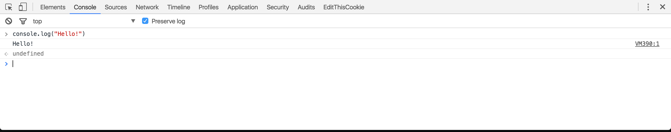
JavaScript tools
Many browsers come with a JavaScript console under Developer Tools
Allows you to see logged output from JavaScript
Allows you to execute JavaScript commands to interact with the web page

Slide 19
JavaScript files vs. the console
> Remember scope?
Only global functions and variables from your web page’s JavaScript files will be accessible via the console. Instead of making everything global (bad practice), you can use console logging to help debug your code.
When JavaScript files included for your web page are executed, only the output from console.log(output) calls will be seen in the console.
When executing JavaScript directly in the console, results from the return statement will also be printed.

Slide 20
JavaScript debugging
Relying on printing to debug is generally not a good practice.
Instead, you can use the debugger; statement as a breakpoint in your code. You can also set breakpoints from the browser via the developer console.
Breakpoint: pauses execution of code at the specified point
Once paused at a breakpoint, you can use debugging tools provided in the console to step through your code line by line. You can also inspect the value of variables at each point to track what is going on in your code!

Slide 21
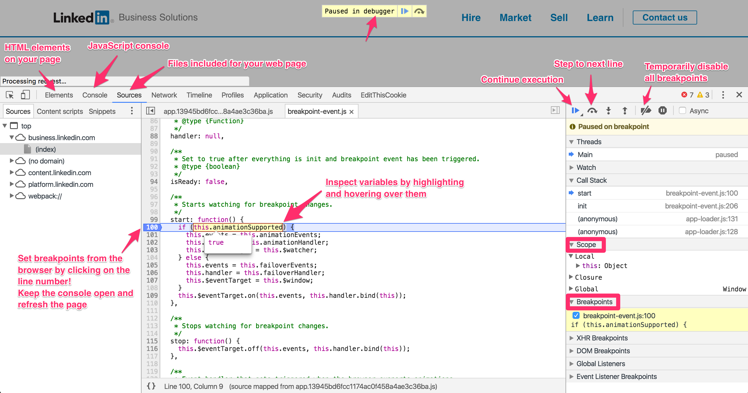

Slide 22
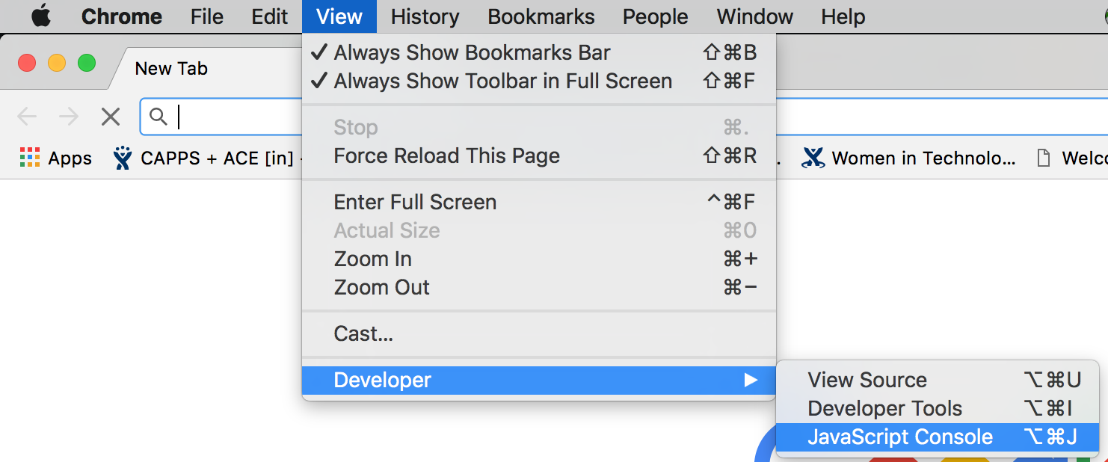
Try it yourself!
Open up a browser and find its console.
Test out some JavaScript you just learned to see output in the console. Practice setting breakpoints, stepping through code, and inspecting variables.
Bonus: use the console to execute JavaScript to manipulate the webpage!

Slide 23
That’s it for the console
Any questions?

Slide 24
References
https://www.w3schools.com/js/js_debugging.asp
http://blog.teamtreehouse.com/mastering-developer-tools-console
http://idratherbewriting.com/events-and-listeners-javascript/
https://www.w3schools.com/js/js_htmldom_eventlistener.asp

